Slide 1
Information System Planning
Information system planning (ISP) is the process of identifying and addressing the information technology needs of an organization.
It involves determining the types of information systems that will support the organization's strategic goals, ensuring that these systems are aligned with business objectives, and planning their implementation and management.
Key Components of Information System Planning:
Assessment of Current Systems: Evaluating existing information systems to understand their capabilities, limitations, and alignment with organizational needs.
Needs Analysis: Identifying the information and technology needs of different departments and stakeholders within the organization.
Strategic Alignment: Ensuring that the information systems support the overall strategic goals and objectives of the organization.
Resource Allocation: Planning for the necessary resources, including budget, personnel, and technology, required to implement and maintain the information systems.
Implementation Plan: Developing a detailed plan for the rollout of new systems, including timelines, milestones, and responsibilities.
Risk Management: Identifying potential risks associated with the implementation and operation of information systems and planning for their mitigation.
Evaluation and Monitoring: Establishing metrics and processes to monitor the performance and effectiveness of the information systems.

Slide 2
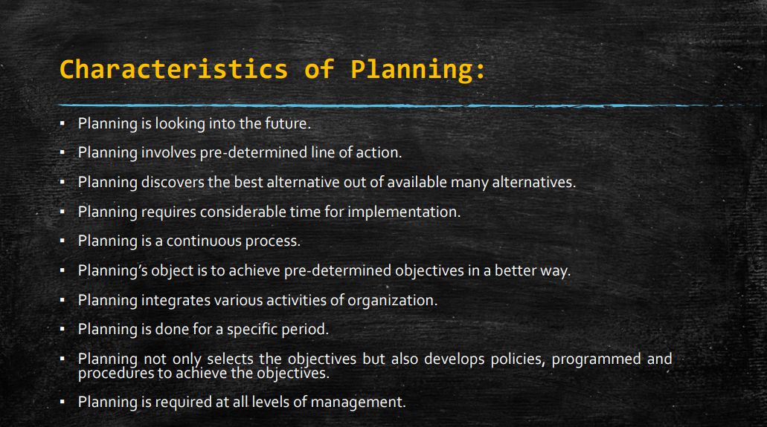

Slide 3
Necessity of ISP
Alignment with Strategic Goals:
Resource Optimization:
Risk Management:
Operational Efficiency:
Future Preparedness:
Integration and Compatibility:
Improved Decision Making:
Stakeholder Satisfaction:
Sustainability and Scalability:
Continuous Improvement:

Slide 4
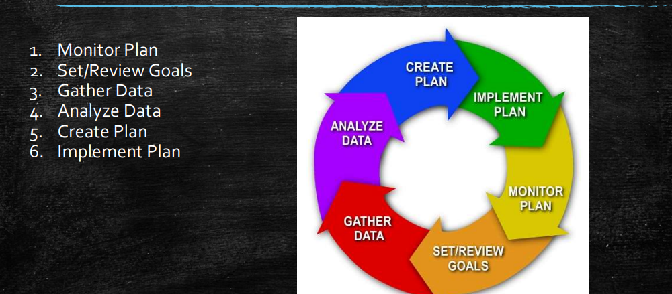
ISP Process

Slide 5
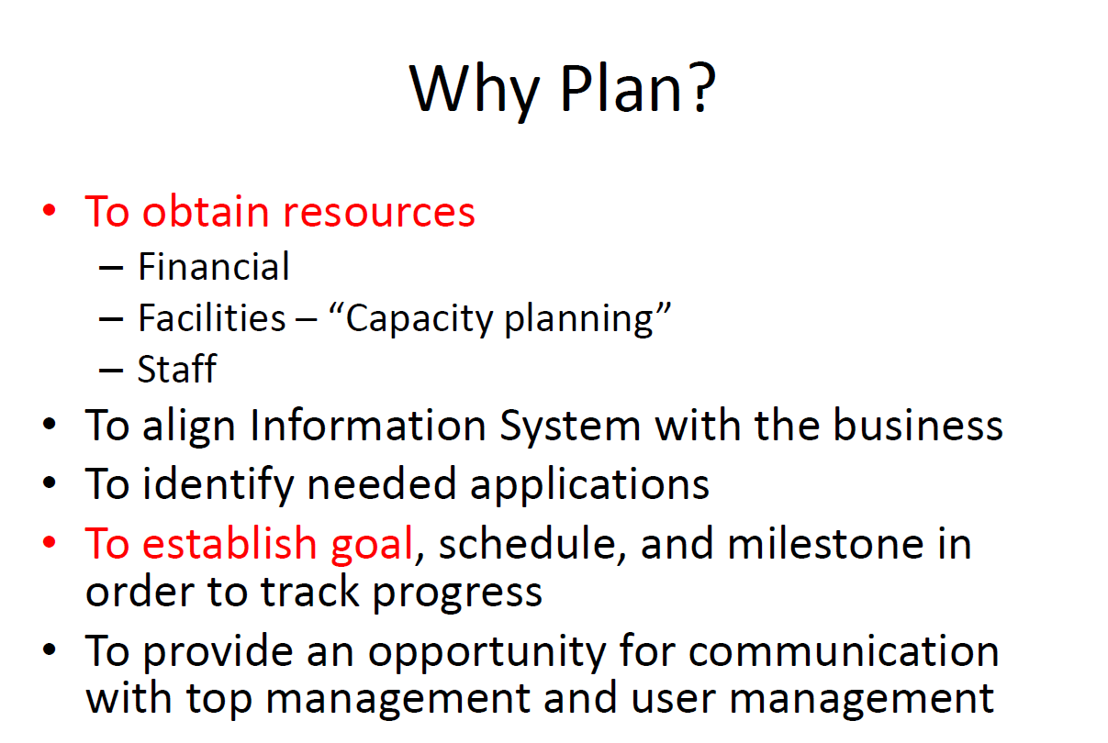

Slide 6
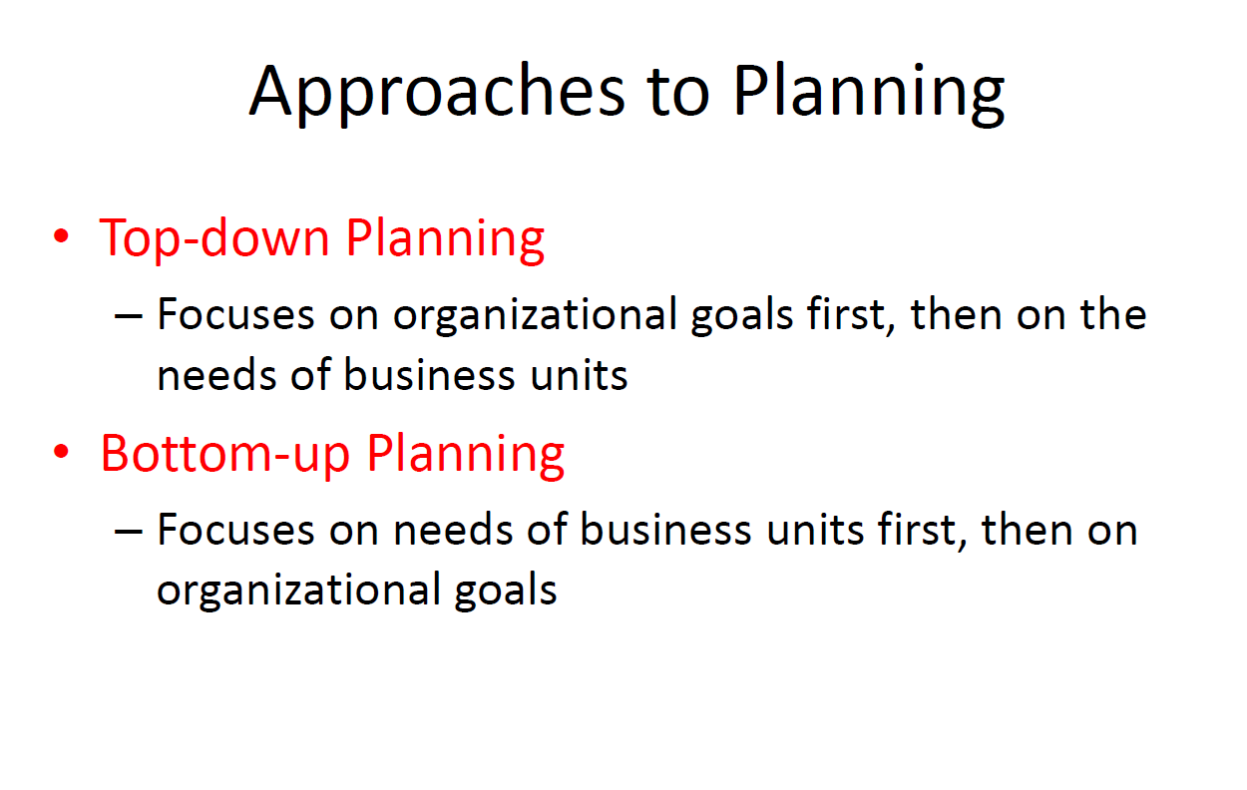

Slide 7
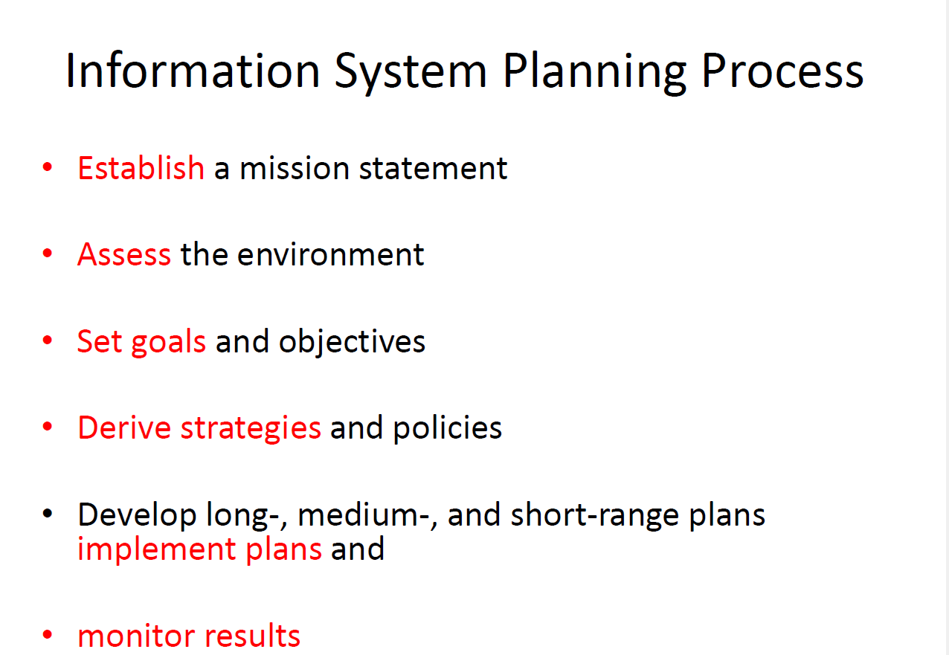

Slide 8
Establish a mission statement
Purpose: The mission statement defines the organization's core purpose and values, serving as a guiding principle for all planning activities.
Process:
Identify Core Values: Determine the fundamental beliefs and principles that drive the organization.
Define Purpose: Clearly articulate what the organization aims to achieve and its primary function in the market.
Align with Business Strategy: Ensure that the mission statement aligns with the overall business strategy and vision.

Slide 9
Set Goals and Objectives
Purpose: Define specific, measurable, achievable, relevant, and time-bound (SMART) goals that the information systems should achieve.
Process:
Identify Key Areas: Determine the critical areas where improvements or new systems are needed.
Define Objectives: Set clear and concise objectives that support the organization’s mission and address the identified needs.
Example: "Reduce system downtime by 30% within the next year" or "Implement a customer relationship management system to improve customer satisfaction scores by 20%."

Slide 10
Derive Strategies and Policies
Purpose: Develop strategies and policies that outline how the organization will achieve its goals and objectives.
Process:
Formulate Strategies: Identify the approaches and initiatives that will be undertaken to meet the objectives (e.g., adopting new technologies, upgrading existing systems).
Develop Policies: Establish guidelines and procedures to govern the use and management of information systems.
Example: "Adopt a cloud-first strategy to enhance scalability and flexibility" or "Implement a data security policy to protect customer information."

Slide 11
Develop Long, Medium, and Short-Range Plans (Implement Plans)
Purpose: Create detailed plans that specify the actions, timelines, and resources needed to execute the strategies.
Process:
Long-Range Plans: Outline initiatives and projects that span several years and align with long-term strategic goals (e.g., major system overhauls, new platform implementations).
Medium-Range Plans: Detail projects and initiatives that will be completed within the next one to three years (e.g., significant upgrades, integration projects).
Short-Range Plans: Focus on immediate actions and projects to be completed within the next year (e.g., routine maintenance, minor enhancements).
Example:
Long-Range Plan: Implement a comprehensive enterprise resource planning (ERP) system over the next five years.
Medium-Range Plan: Integrate the CRM system with the existing sales platform within the next two years.
Short-Range Plan: Upgrade the network infrastructure within the next six months.

Slide 12
Monitor Results
Purpose: Continuously track the progress and effectiveness of the implemented plans to ensure they meet the set goals and objectives.
Process:
Establish Metrics: Define key performance indicators (KPIs) to measure the success of the information systems (e.g., system uptime, customer satisfaction, project completion rates).
Regular Reviews: Conduct regular reviews and assessments to monitor progress, identify issues, and make necessary adjustments.
Feedback Mechanisms: Implement feedback mechanisms to gather input from stakeholders and users to improve the systems.
Example: Monthly reviews of system performance reports, quarterly user satisfaction surveys, and annual strategic assessments to ensure alignment with business goals.

Slide 13
Establish a mission statement
Purpose: The mission statement defines the organization's core purpose and values, serving as a guiding principle for all planning activities.
Process:
Identify Core Values: Determine the fundamental beliefs and principles that drive the organization.
Define Purpose: Clearly articulate what the organization aims to achieve and its primary function in the market.
Align with Business Strategy: Ensure that the mission statement aligns with the overall business strategy and vision.

Slide 14
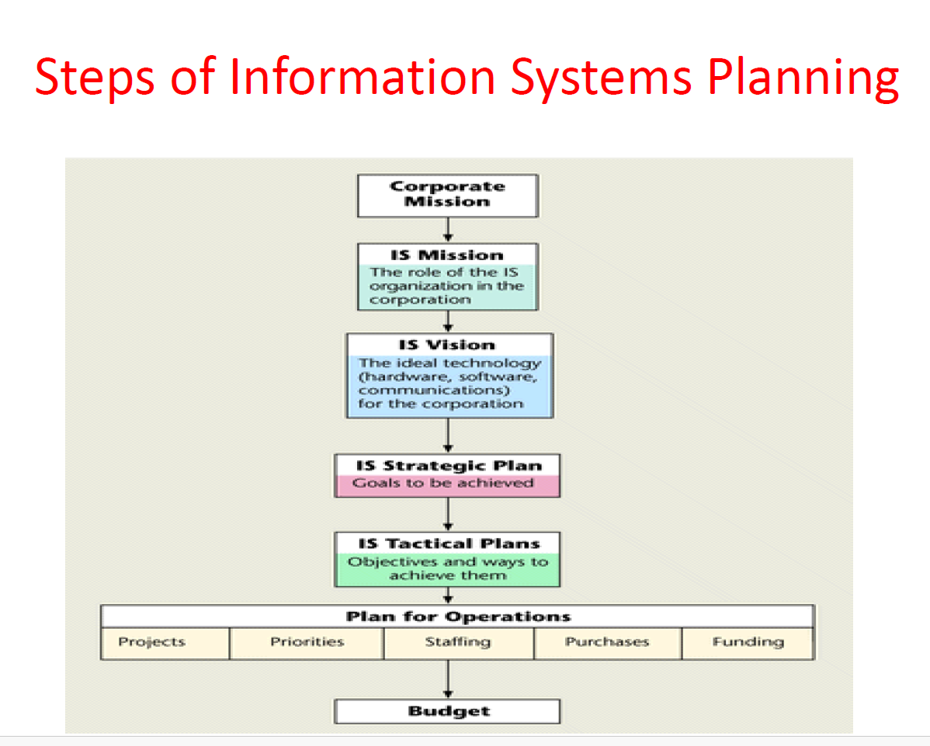

Slide 15
Steps
1. Corporate Mission
Define Corporate Mission: Establish the organization’s core purpose and values, guiding the overall direction of business activities.
Example: "To deliver high-quality products/services that exceed customer expectations while maintaining integrity and profitability."
2. Information Systems (IS) Mission
Develop IS Mission: Create a mission statement specific to information systems that supports the corporate mission.
Example: "To provide secure, reliable, and innovative technology solutions that enhance operational efficiency and support strategic growth initiatives."

Slide 16
Steps
3. Information Systems (IS) Vision
Formulate IS Vision: Define the long-term aspirations for information systems within the organization.
Example: "To be recognized as a leader in leveraging technology to drive competitive advantage and operational excellence.“
4. Information Systems (IS) Strategic Plan
Establish IS Strategic Plan: Outline high-level goals and strategies for information systems that align with the corporate strategy.
Components:
Strategic Goals: Specific objectives that information systems aim to achieve (e.g., improve data security, enhance customer experience).
Strategies: Approaches to achieve the strategic goals (e.g., implement cloud-based solutions, enhance data analytics capabilities).

Slide 17
Steps
5. Information Systems (IS) Tactical Plans
Develop IS Tactical Plans: Detail specific initiatives and projects that support the IS strategic plan.
Components:
Project Plans: Detailed plans for individual projects, including timelines, milestones, resources, and responsibilities.
Priorities: Ranking of projects based on strategic importance and impact on organizational goals.
Staffing Plan: Identify and allocate human resources needed for each project, including skills and expertise required.
Purchases Plan: Outline technology and equipment purchases necessary to support the projects and initiatives.
Funding Plan: Budget allocation for each project, ensuring adequate resources for implementation and maintenance.

Slide 18
Steps
6. Plan for Operations
Define Operations Plan: Establish operational strategies and procedures to support ongoing maintenance and management of information systems.
Components:
Project Management: Methodologies and frameworks for project execution and monitoring (e.g., Agile, Waterfall).
Priorities: Setting priorities for ongoing maintenance and support activities.
Staffing: Staffing levels and roles required to support ongoing operations and maintenance.
Purchases: Procurement processes for ongoing technology and equipment needs.
Funding: Allocation of funds for operational expenses and contingencies.
7. Budget
Develop Budget: Create a detailed budget that aligns with the IS strategic and tactical plans, ensuring financial resources are allocated appropriately.
Components:
Capital Expenditures: Investments in hardware, software, and infrastructure.
Operating Expenses: Costs for staffing, training, maintenance, and ongoing support.
Contingency Funds: Reserves for unexpected expenses or changes in project scope.
Budget Allocation: Allocation of funds across different projects and operational activities based on priorities and strategic goals.

Slide 19
Example
Example Integration:
For instance, in a retail company:
Corporate Mission: Provide high-quality products and services to enhance customer satisfaction.
IS Mission: Enable efficient operations and customer service through innovative technology solutions.
IS Vision: Lead in leveraging technology for competitive advantage and operational excellence.
IS Strategic Plan: Improve online customer experience through a new e-commerce platform.
IS Tactical Plans: Implement the new platform in phases, enhance cybersecurity measures, and integrate with existing ERP systems.
Plan for Operations: Maintain and support the new platform, prioritize customer service enhancements, manage IT resources effectively.
Budget: Allocate funds for platform development, cybersecurity upgrades, ongoing maintenance, and staff training.

Slide 20
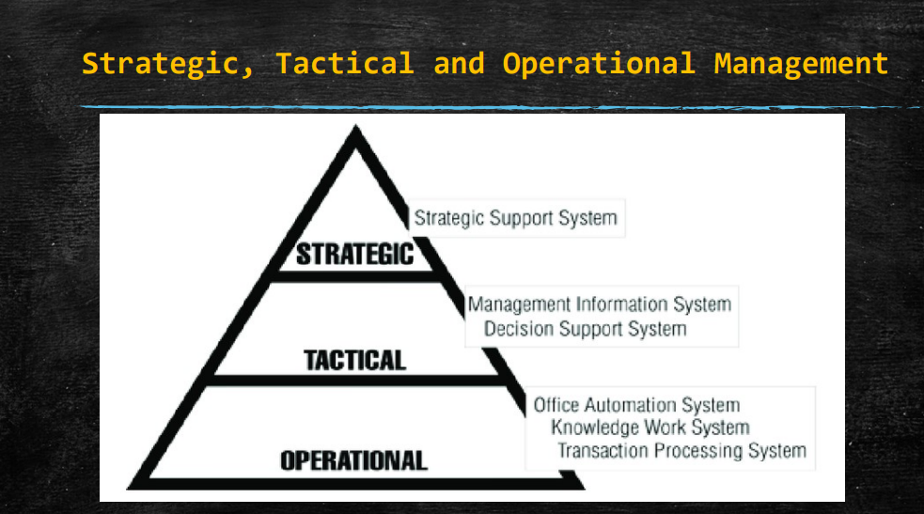

Slide 21
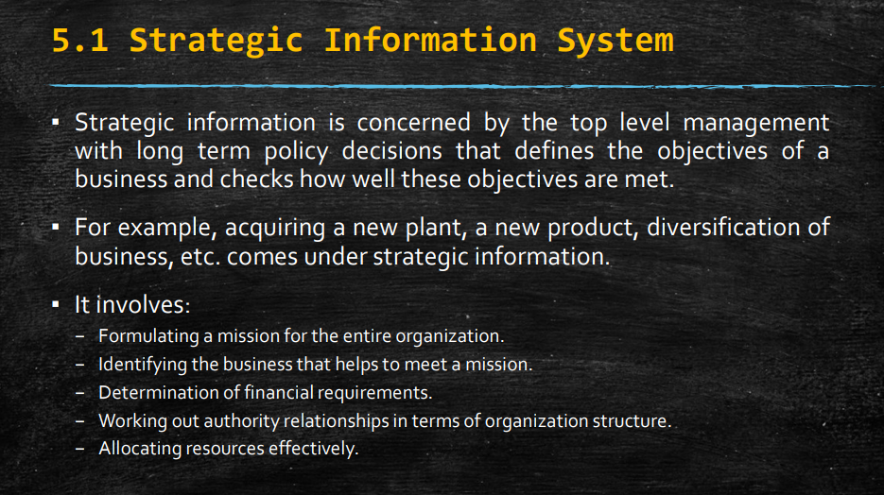

Slide 22
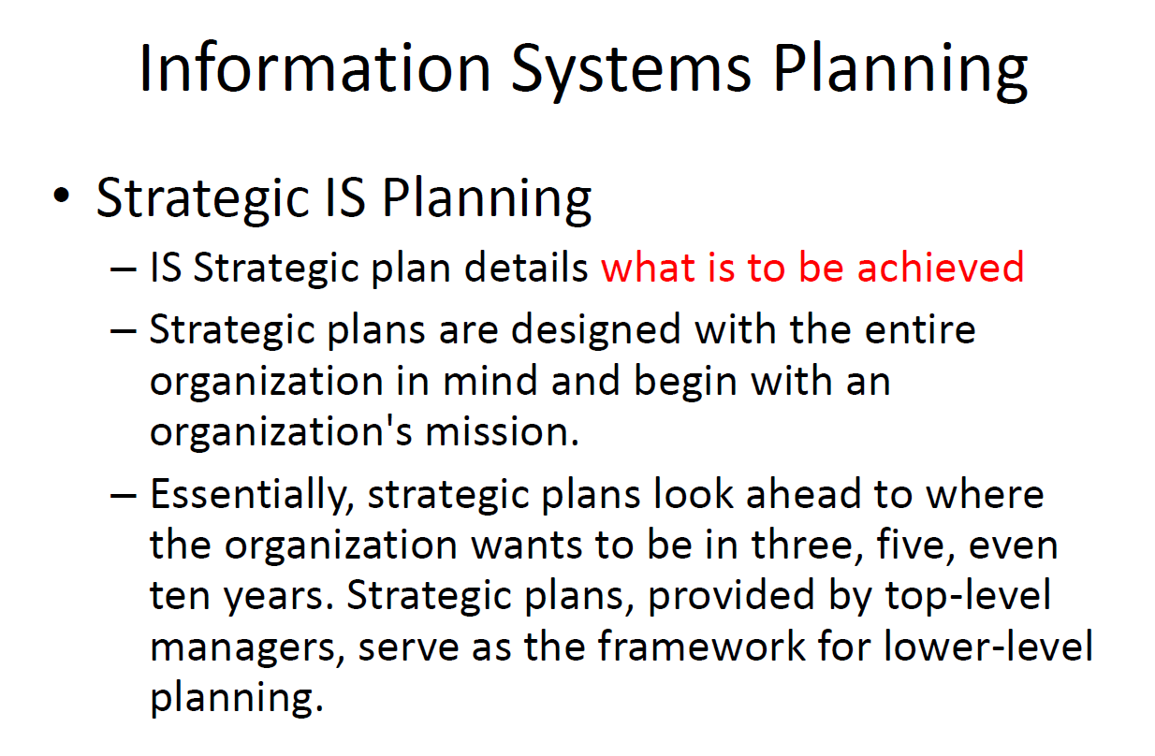

Slide 23
Strategic IS Planning
Strategic Information Systems (IS) planning refers to the process of identifying, prioritizing, and aligning IT initiatives with an organization's strategic goals and objectives.
It involves developing a comprehensive roadmap for how information technology can be leveraged to achieve competitive advantage, enhance operational efficiency, and support overall business strategies.
Key Aspects of Strategic IS Planning:
Alignment with Business Strategy:
Long-Term Focus:

Slide 24
Key components
Key Components of Strategic Information System Planning:
Environmental Analysis:
Internal Analysis: Evaluate current IT infrastructure, systems, and capabilities within the organization. Assess strengths, weaknesses, resources, and IT governance structures.
External Analysis: Identify and analyze external factors such as market trends, technological advancements, regulatory changes, and competitive landscape. This may involve using tools like SWOT analysis (Strengths, Weaknesses, Opportunities, Threats) and PEST analysis (Political, Economic, Social, Technological factors).
Corporate Strategy Alignment:
Ensure that the IT strategy aligns closely with the overall corporate strategy and business objectives. IT initiatives should directly contribute to achieving organizational goals, such as market expansion, cost reduction, or customer satisfaction improvement.
Identification of Strategic IT Opportunities:
Identify opportunities where IT can provide significant strategic value. This could involve exploring new technologies, digital transformation initiatives, or innovative ways to enhance customer experience and operational efficiency.
Development of IT Strategy:
Strategic Goals: Define specific and measurable goals that IT initiatives will address. Examples include enhancing cybersecurity, improving data analytics capabilities, or implementing new systems for better decision-making.
Strategic Initiatives: Outline the high-level initiatives and projects required to achieve the strategic goals. Prioritize these initiatives based on their potential impact and alignment with organizational priorities.

Slide 25
Key components
Resource Allocation:
Allocate resources (financial, human, and technological) to support the implementation of strategic IT initiatives. Develop a budget that aligns with the IT strategy and ensures adequate funding for key projects.
Risk Management:
Identify potential risks associated with IT initiatives, such as cybersecurity threats, technology adoption challenges, or operational disruptions. Develop mitigation strategies to minimize these risks and ensure smooth implementation.
Implementation and Execution:
Develop detailed implementation plans for each strategic IT initiative. This includes defining project timelines, milestones, responsibilities, and monitoring mechanisms to track progress.
Ensure effective change management processes are in place to manage organizational transitions and stakeholder expectations during implementation.
Monitoring and Evaluation:
Continuously monitor the progress and performance of IT initiatives against predefined metrics and KPIs. Evaluate the effectiveness of implemented strategies in achieving desired outcomes.
Use feedback and performance data to make adjustments, improvements, and course corrections as necessary to ensure ongoing alignment with strategic objectives.
Alignment with Emerging Technologies:
Stay abreast of emerging technologies and industry trends that could impact the organization's strategic objectives. Plan for the integration of new technologies that offer competitive advantages or operational efficiencies.

Slide 26
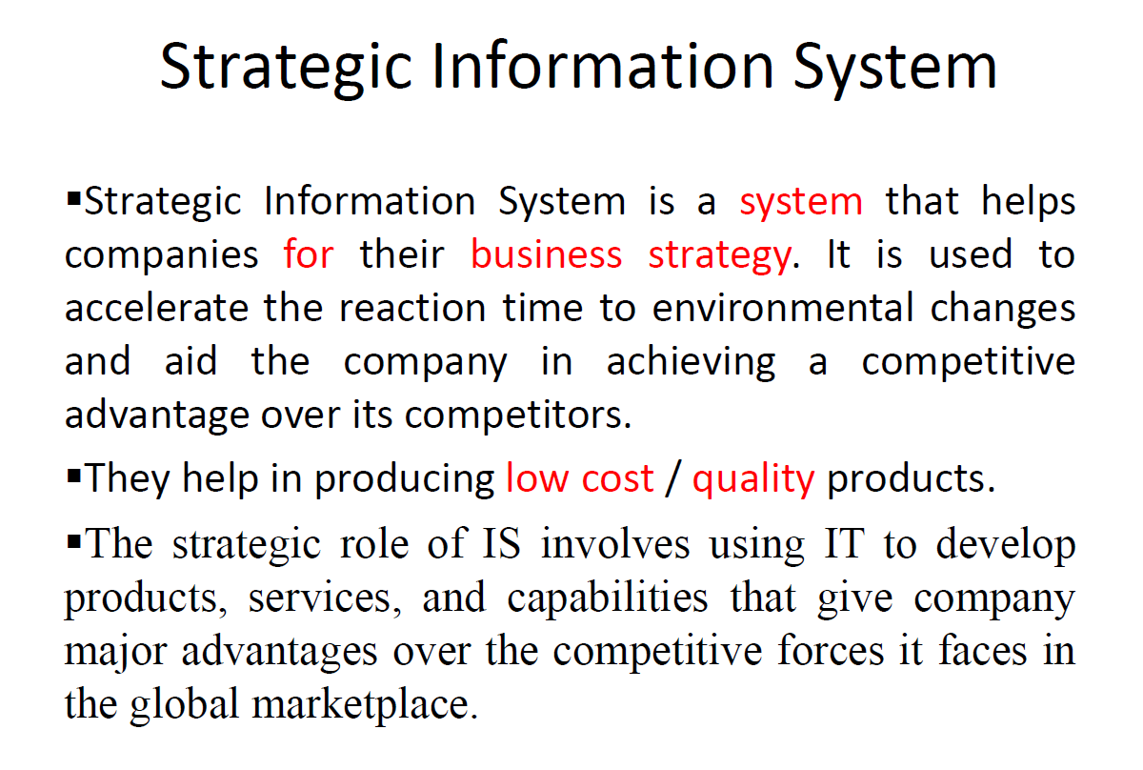

Slide 27
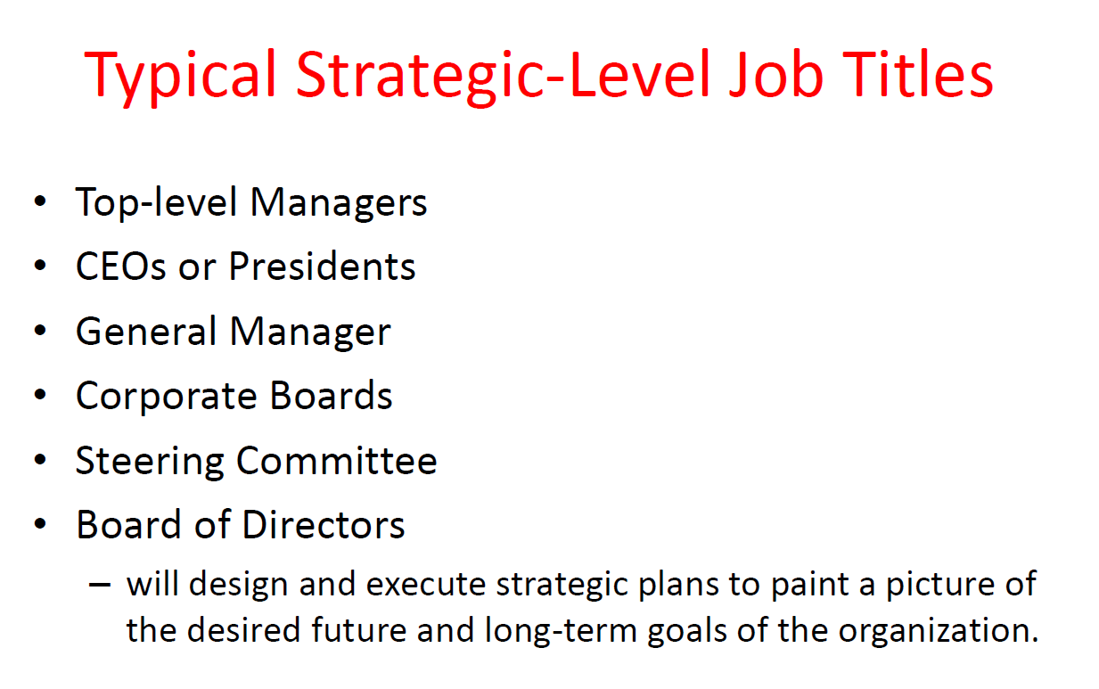

Slide 28
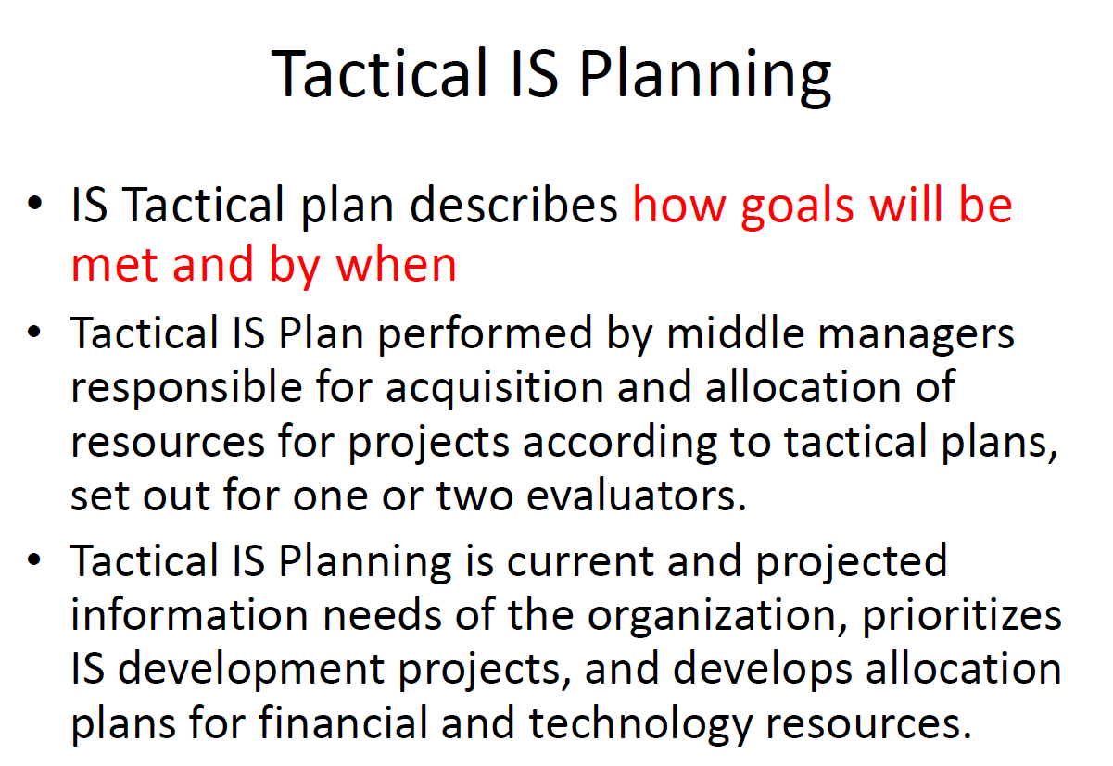
Tactical ISP

Slide 29
Tactical ISP
Tactical Information Systems (IS) planning focuses on the implementation and execution of specific IT projects and initiatives that support the broader strategic goals set forth in strategic IS planning.
While strategic IS planning sets the overall direction and long-term objectives for IT within an organization, tactical IS planning translates these objectives into actionable plans and projects.

Slide 30
Key Components of Tactical IS Planning:
Project Identification and Prioritization:
Project Selection: Identify specific IT projects and initiatives that align with the strategic goals and priorities defined in strategic IS planning.
Prioritization: Rank projects based on their importance, potential impact on business outcomes, and alignment with organizational objectives.
Detailed Project Planning:
Scope Definition: Clearly define the scope, objectives, deliverables, and outcomes of each IT project.
Timeline and Milestones: Develop a timeline with specific milestones and deadlines for project completion.
Resource Allocation: Allocate resources such as budget, personnel, and technology infrastructure needed to execute the project successfully.
Implementation Strategy:
Methodology: Select an appropriate project management methodology (e.g., Agile, Waterfall) based on project requirements and organizational preferences.
Risk Management: Identify potential risks and develop mitigation strategies to minimize disruptions and ensure project success.
Change Management: Plan for organizational changes that may arise from implementing new IT systems or processes, including communication strategies and stakeholder engagement.

Slide 31
Key Components of Tactical IS Planning:
Monitoring and Control:
Progress Tracking: Monitor the progress of each project against defined milestones and timelines.
Quality Assurance: Implement quality assurance processes to ensure that project deliverables meet predefined standards and requirements.
Budget Management: Monitor and manage project budgets to ensure expenditures align with approved allocations and financial constraints.
Communication and Stakeholder Engagement:
Communication Plan: Develop a communication strategy to keep stakeholders informed about project progress, milestones achieved, and potential impacts on operations.
Stakeholder Engagement: Engage key stakeholders throughout the project lifecycle to gather feedback, address concerns, and ensure alignment with organizational objectives.
Evaluation and Adjustment:
Post-Implementation Review: Conduct a post-implementation review to evaluate the success of the project in achieving its objectives.
Lessons Learned: Identify lessons learned from the project execution process and incorporate them into future tactical IS planning efforts.
Continuous Improvement: Use evaluation findings to refine strategies, processes, and project management practices to enhance efficiency and effectiveness in future projects.

Slide 32
Example
Example Application:
For example, a healthcare organization might undertake tactical IS planning to implement a new electronic health records (EHR) system:
Project Identification: Selecting a vendor and defining the scope of the EHR implementation project.
Detailed Planning: Creating a project plan with timelines for system configuration, user training, and go-live phases.
Implementation Strategy: Choosing an Agile approach to accommodate iterative testing and user feedback.
Monitoring and Control: Tracking project progress through regular meetings, milestone reviews, and budget monitoring.
Communication and Stakeholder Engagement: Communicating updates to clinicians, administrators, and IT staff, and addressing user concerns through training and support.
Evaluation and Adjustment: Conducting a post-implementation review to assess user adoption rates, system performance, and alignment with organizational goals.

Slide 33
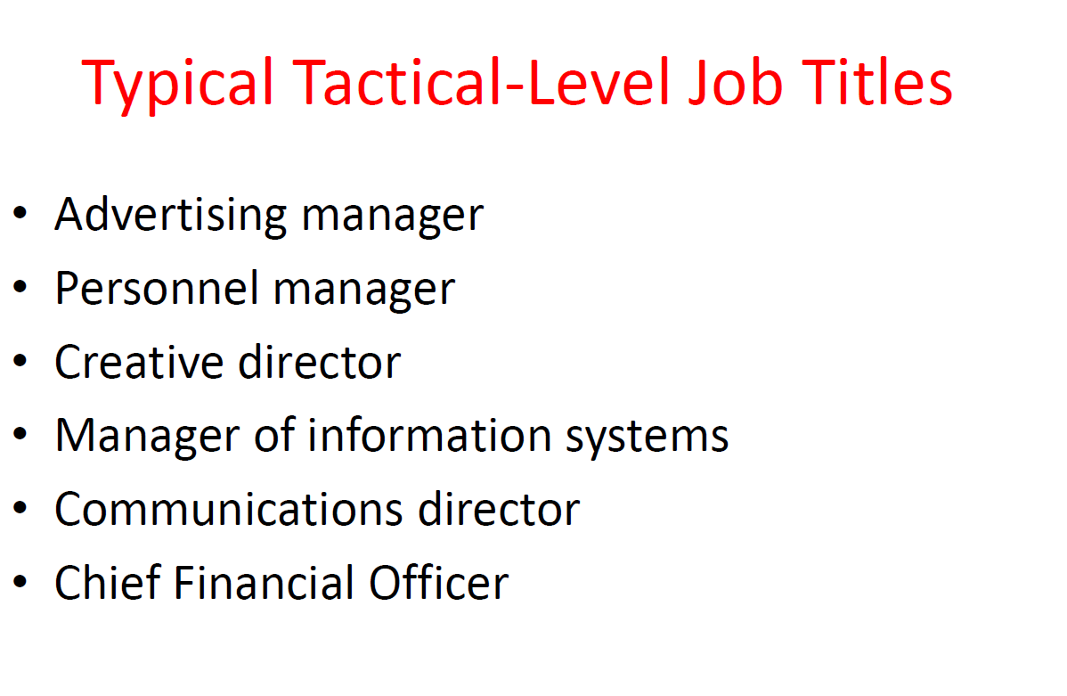

Slide 34
Operational ISP
Operational Information System (IS) planning focuses on the day-to-day management and maintenance of IT systems and infrastructure to ensure they effectively support organizational operations.
Unlike strategic or tactical IS planning, which deal with long-term goals and specific projects, operational IS planning involves ongoing activities and processes that keep IT systems running smoothly and meeting business needs on a daily basis.

Slide 35
Operational ISP
Key Components of Operational IS Planning:
Routine Maintenance and Support:
System Maintenance: Regularly schedule updates, patches, and upgrades to keep software and hardware systems current and secure.
Technical Support: Establish procedures and resources for addressing user issues, troubleshooting problems, and providing technical assistance.
Capacity Planning:
Resource Allocation: Monitor and manage IT resources such as server capacity, storage space, and network bandwidth to ensure adequate performance.
Scalability: Plan for future growth and expansion by assessing current capacity utilization and forecasting future requirements.
Backup and Disaster Recovery:
Data Backup: Implement and maintain regular data backup procedures to protect against data loss due to hardware failure, human error, or cybersecurity threats.
Disaster Recovery: Develop and test a disaster recovery plan to ensure continuity of operations in the event of a major disruption or outage.
Security Management:
Cybersecurity Measures: Implement security protocols, firewalls, encryption, and access controls to protect sensitive data and systems from unauthorized access and cyber threats.
Compliance: Ensure compliance with industry regulations and standards related to data privacy and security (e.g., GDPR, HIPAA).

Slide 36
Operational ISP
User Training and Support:
Training Programs: Provide ongoing training and education for users to optimize their use of IT systems and applications.
User Support: Establish a help desk or support system to address user inquiries, troubleshoot issues, and provide guidance on system usage.
Vendor Management:
Vendor Relationships: Manage relationships with IT vendors and service providers to ensure service level agreements (SLAs) are met and obtain timely support for system maintenance and upgrades.
Contract Management: Negotiate contracts, renewals, and pricing terms with vendors to optimize cost-effectiveness and service delivery.
Performance Monitoring and Reporting:
Monitoring Tools: Deploy monitoring tools and software to track system performance metrics such as uptime, response times, and resource utilization.
Reporting: Generate reports and dashboards to provide insights into IT performance, identify trends, and support decision-making for resource allocation and future planning.
Continuous Improvement:
Feedback Mechanisms: Gather feedback from users and stakeholders to identify areas for improvement and enhancement of IT systems and services.
Process Optimization: Implement continuous improvement initiatives to streamline workflows, enhance efficiency, and reduce operational costs over time.

Slide 37
Example
Example Application:
For instance, a manufacturing company might focus on operational IS planning to:
Ensure regular updates and maintenance of production line control systems to minimize downtime and maximize productivity.
Implement robust cybersecurity measures to protect proprietary designs and customer data from cyber threats.
Provide ongoing training for staff on new ERP software features to improve inventory management and streamline supply chain operations.

Slide 38
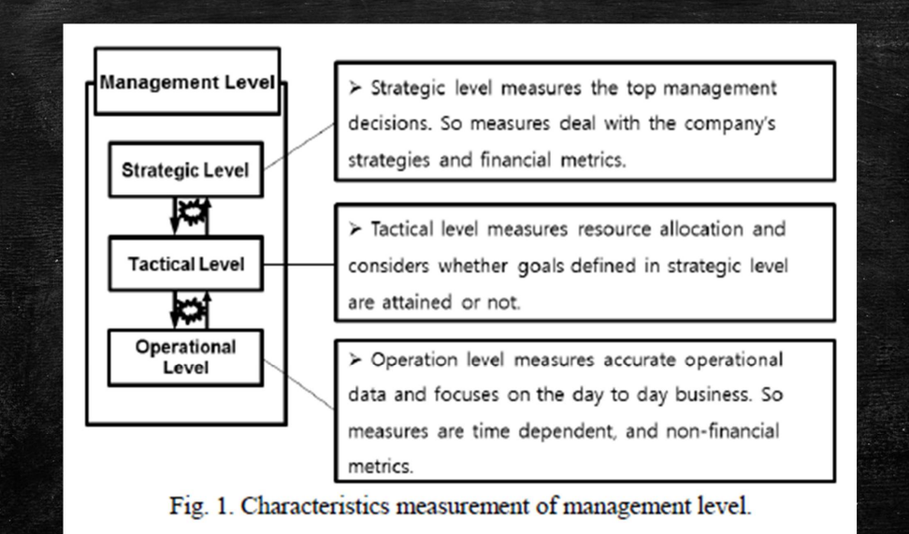

Slide 39
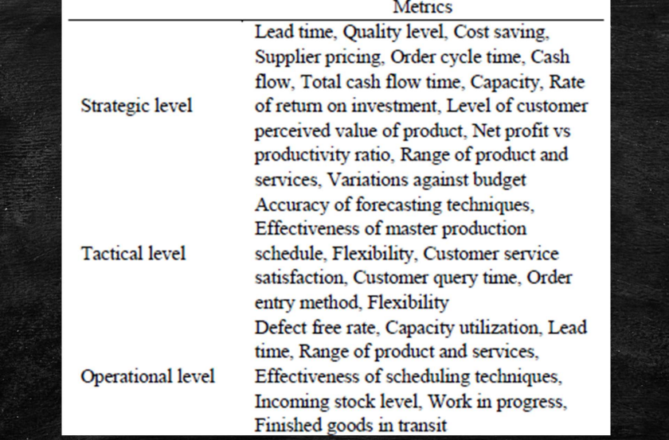

Slide 40
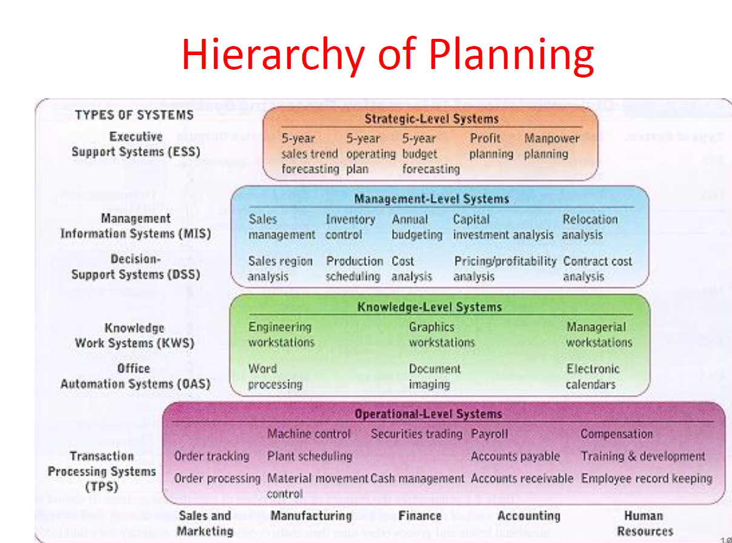

Slide 41
